Slide 1

How to Use Colab (Google Colaboratory)
Information & Intelligence System Lab.
Sungkyunkwan University

Slide 2
Tutorials
Welcome To Colaboratory
[en] https://colab.research.google.com/notebooks/welcome.ipynb
[ko] https://colab.research.google.com/notebooks/welcome.ipynb?hl=ko
Get started with Google Colaboratory (Coding TensorFlow)
https://youtu.be/inN8seMm7UI
Korean CC supported

Slide 3
Colab (1/2)
Free!
12-hour runtime per session
Disconnects without action within 90 minutes
Requires Google account
.ipynb format
Colab Pro (Faster GPUs, Longer Runtimes, More Memory)

Slide 4
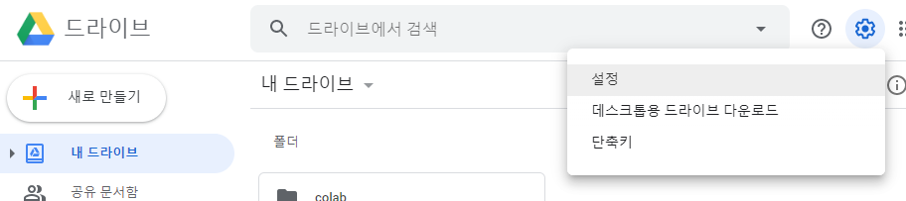
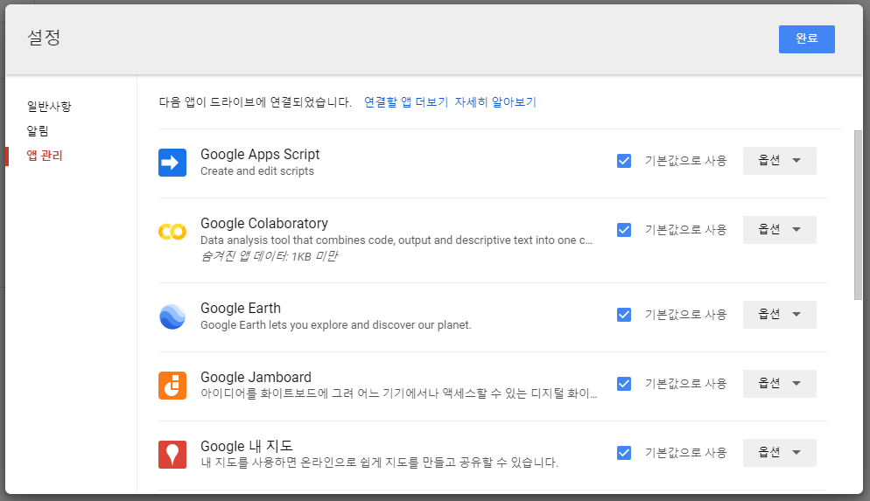
Colab (2/2)

Slide 5
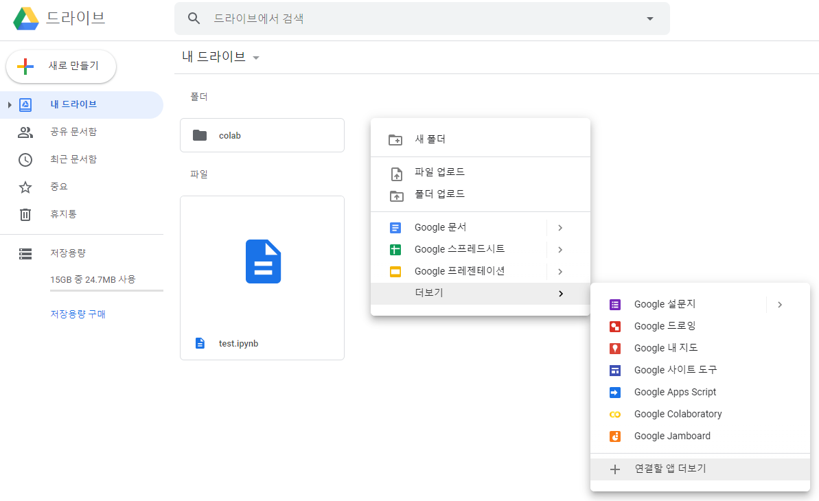
Open a Notebook (1/3)

Slide 6
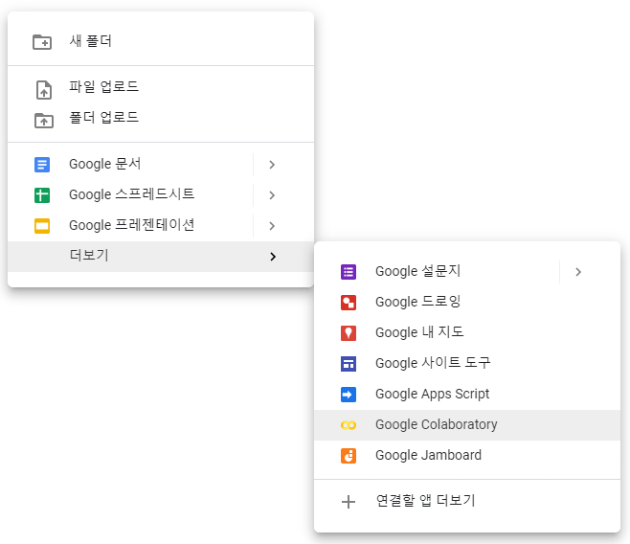
Open a Notebook (2/3)
Notes:
https://drive.google.com/file/d/1zcQGq_21zT6up5hED9iqj9QLpV_YcshP/view?usp=sharing

Slide 7
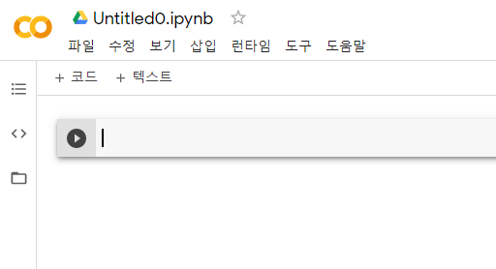
Open a Notebook (3/3)

Slide 8
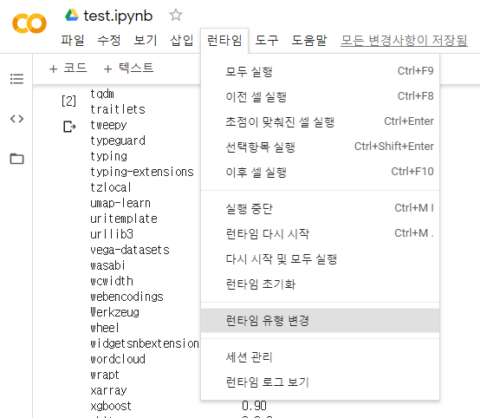
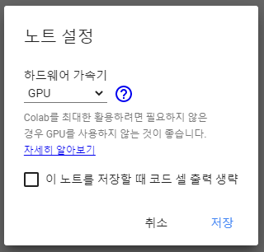
Change Runtime

Slide 9
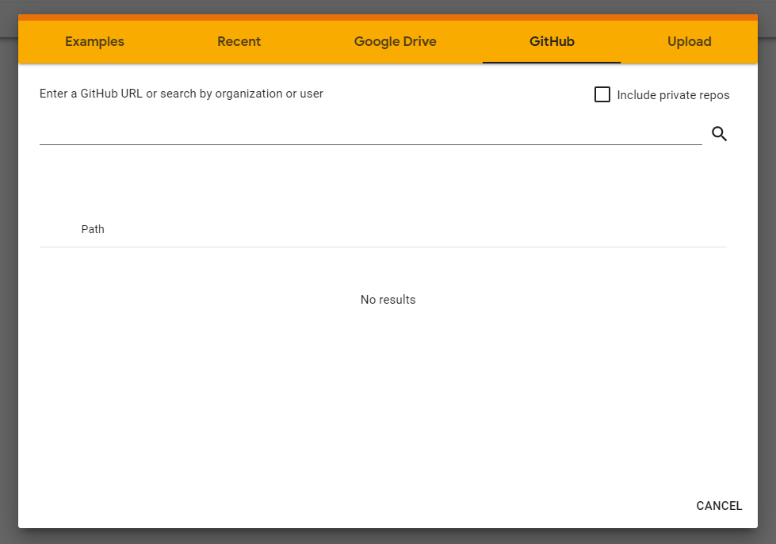
Access GitHub (1/3)

Slide 10
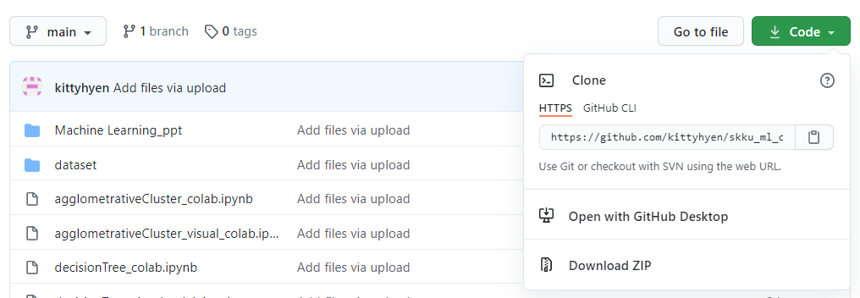
Access GitHub (2/3)

Slide 11
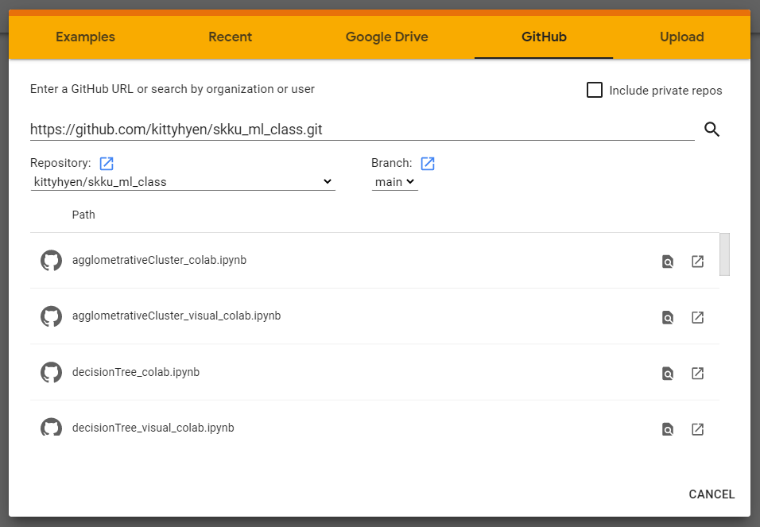
Access GitHub (3/3)

